Slide 1
Iterative reconstruction in low dose CT with Artificial Neural Network
By, Harshitha Govindaraju
Instructor : Dr. Nada N. Boustany
Course : Bioimaging Methods

Slide 2
Overview
Background
Introduction
Basic Concept
Algebraic derivation
Classification
SIRT
Other Recon Methods
Advantages
Disadvantages
Image Reconstruction with Deep Learning

Slide 3



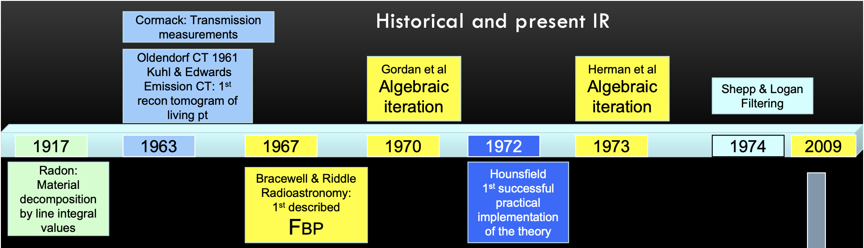
Background
Concept proposed during 1970s
Mathematically demanding
Large Amount of data
Gordon, R; Bender, R; Herman, GT (December 1970). "Algebraic reconstruction techniques (ART) for three-dimensional electron microscopy and x-ray photography". Journal of Theoretical Biology. 29 (3): 471–81. doi:10.1016/0022-5193(70)90109-8. PMID 5492997.

Slide 4
Classification
Analytical Methods
Filtered Back Projection
Convolution
Radon’s Method
Fourier Filtering
2D, 3D Fourier Recon
Iterative Methods
Algebraic Reconstruction Technique (ART)
Simultaneous Iterative Reconstruction Technique (SIRT)
Simultaneous Algebraic Reconstruction Technique (SART)
Iterative Least Square Tech(ILST)

Slide 5
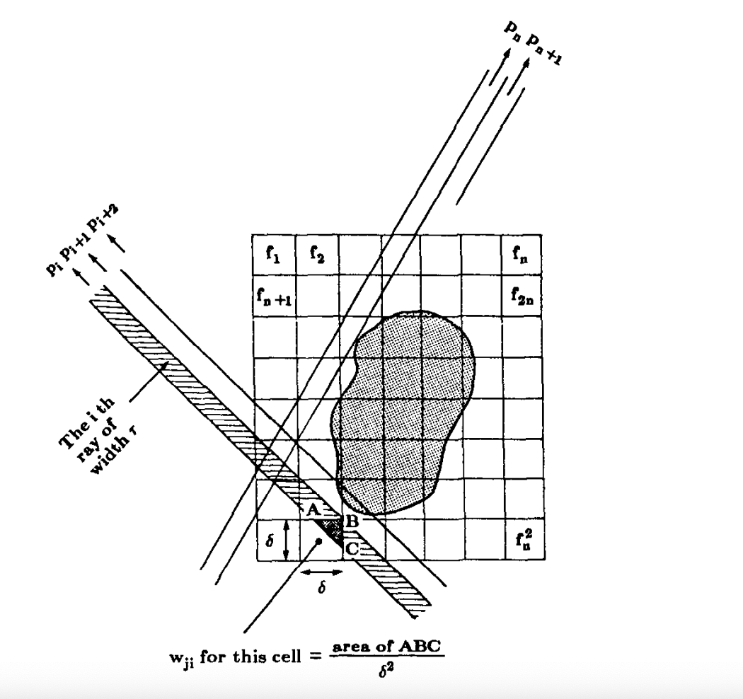
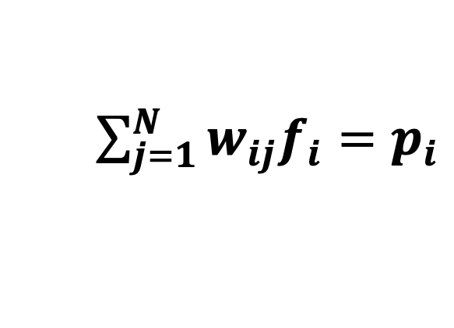
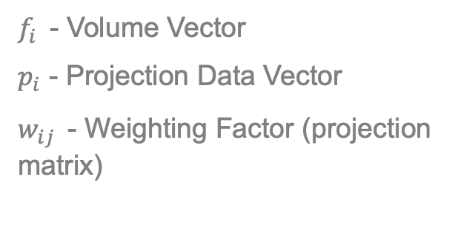
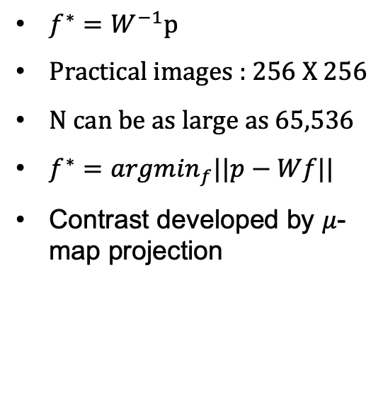
Basic Concept – Algebraic Reconstruction
$\sum_{j=1}^{N}{w_{ij}f_{i}}$ $=$ $p_{i}$
$f_{i }$ - Volume Vector
$p_{i}$ - Projection Data Vector
$w_{ij }$ - Weighting Factor (projection matrix)
$f^{∗}=W^{−1}p$
Practical images : 256 X 256
N can be as large as 65,536
$f^{∗}={argmin}_{f}||p−Wf||$
Contrast developed by $μ$-map projection
A. C. Kak and Malcolm Slaney, Principles of Computerized Tomographic Imaging, IEEE Press, 1988.

Slide 6
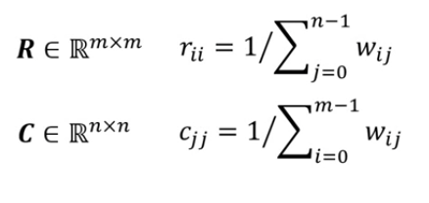
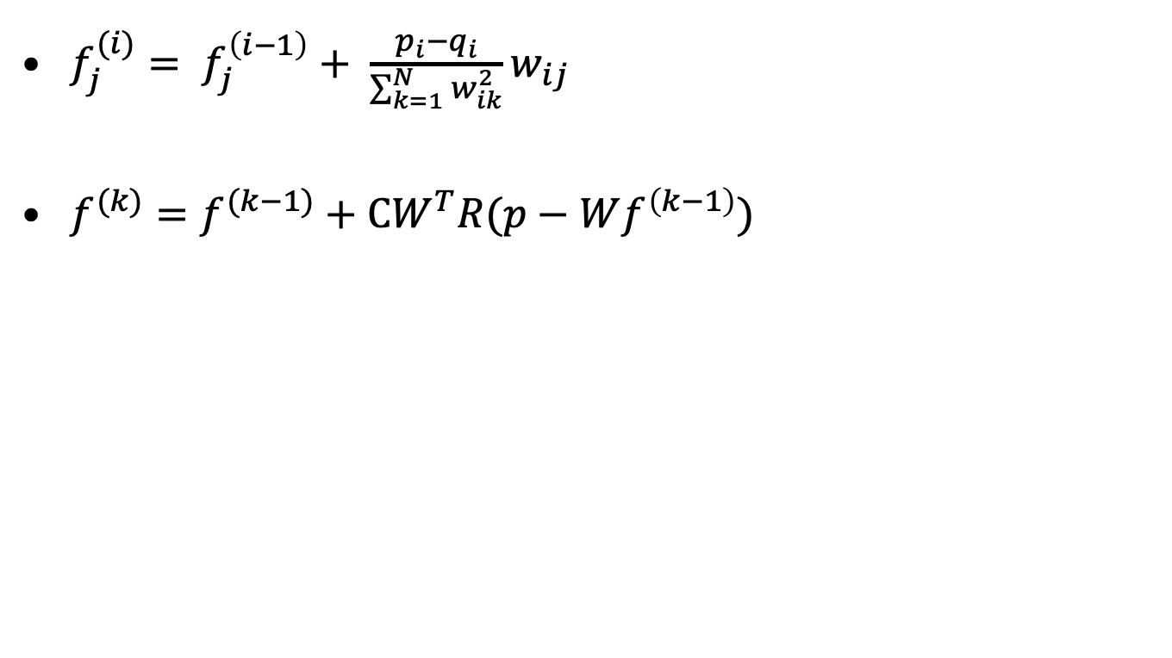
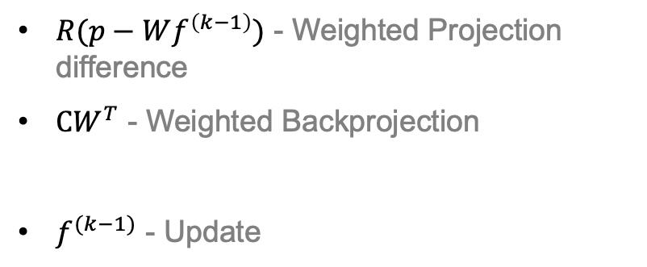
Concept
$f_{j}^{(i)}= f_{j}^{\left(i−1\right)}+ \frac{p_{i}−q_{i}}{\sum_{k=1}^{N}{w_{ik}^{2}}}w_{ij}$
$f^{(k)}=f^{(k−1)}+CW^{T}R(p−Wf^{\left(k−1\right)})$
1
$R(p−Wf^{\left(k−1\right)})$ - Weighted Projection difference
$CW^{T}$ - Weighted Backprojection
$f^{(k−1)}$ - Update
1
A. C. Kak and Malcolm Slaney, Principles of Computerized Tomographic Imaging, IEEE Press, 1988.

Slide 7
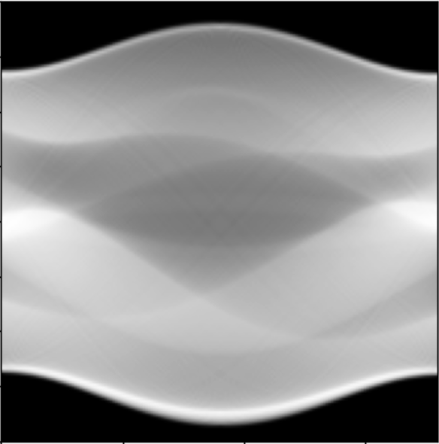
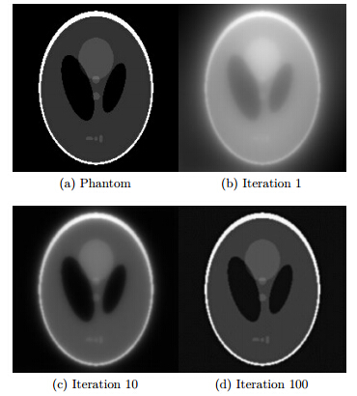
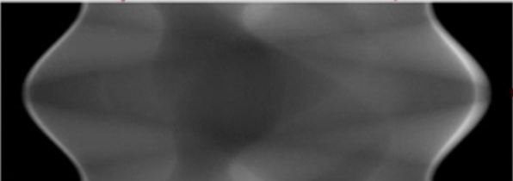
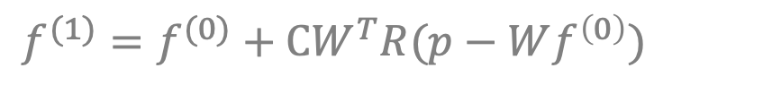
SIRT
$f^{(1)}=f^{(0)}+CW^{T}R(p−Wf^{\left(0\right)})$
Forward Projection
Update
Weighted Projection Difference
Weighted backprojection Difference

Slide 8
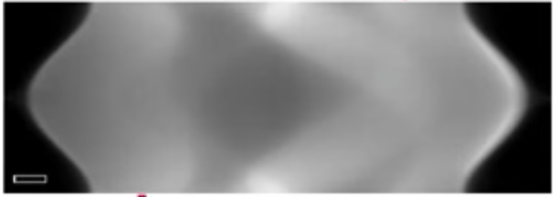
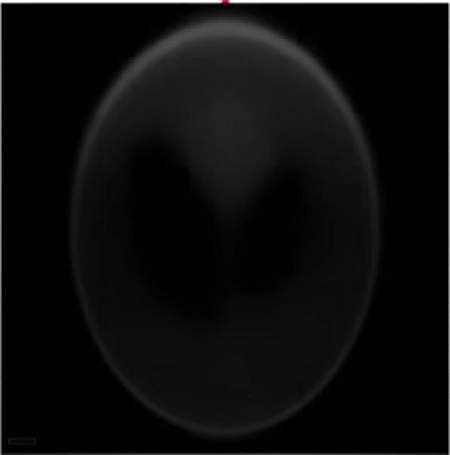
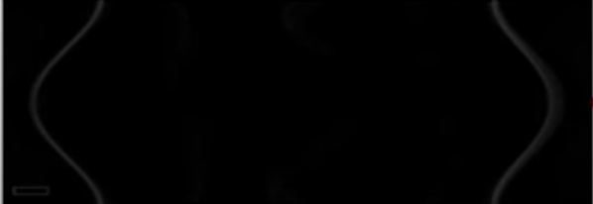
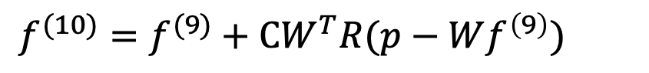
SIRT
$f^{(10)}=f^{(9)}+CW^{T}R(p−Wf^{\left(9\right)})$
Forward Projection
Update
Weighted Projection Difference
Weighted Backprojection Difference

Slide 9
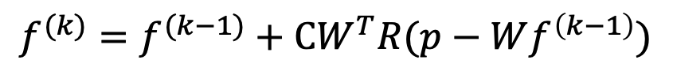
$f^{(k)}=f^{(k−1)}+CW^{T}R(p−Wf^{\left(k−1\right)})$
Forward Projection
Update
Weighted Projection Difference
Weighted Backprojection Difference

Slide 10


Other Algebraic Reconstruction Methods
ART – updates only a single measurement with iteration
SART – updates all measurements of a single projection in each iteration

Slide 11
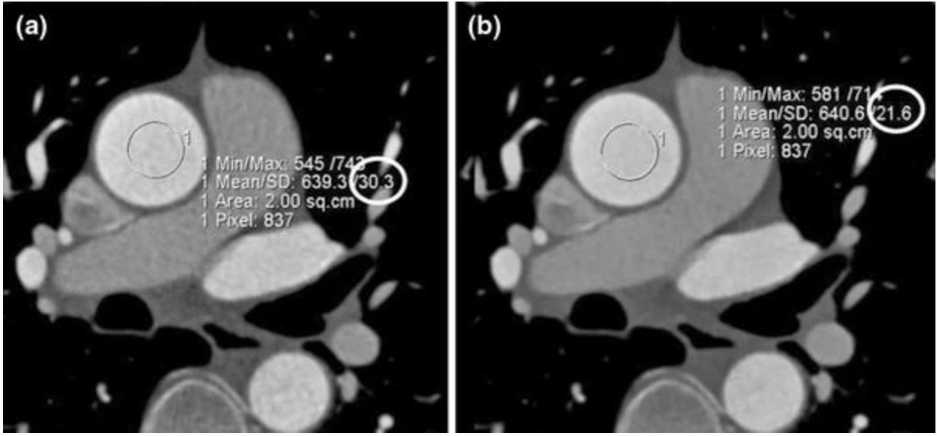



Advantages
Reduced noise with no impact on spatial or contrast resolution
Optimal reconstruction with limited data
(a) FBP | (b)IR
Image noise expressed as the standard deviation of the attenuation (HU)
Can overcome problems when projection data are not distributed uniformly in angles
1. Iterative Reconstruction in CT: What Does It Do? How Can I Use It? William P. Shuman, MD, FACR, FSCBTMR, FSCCT University of Washington School of Medicine, Seattle, WA

Slide 12
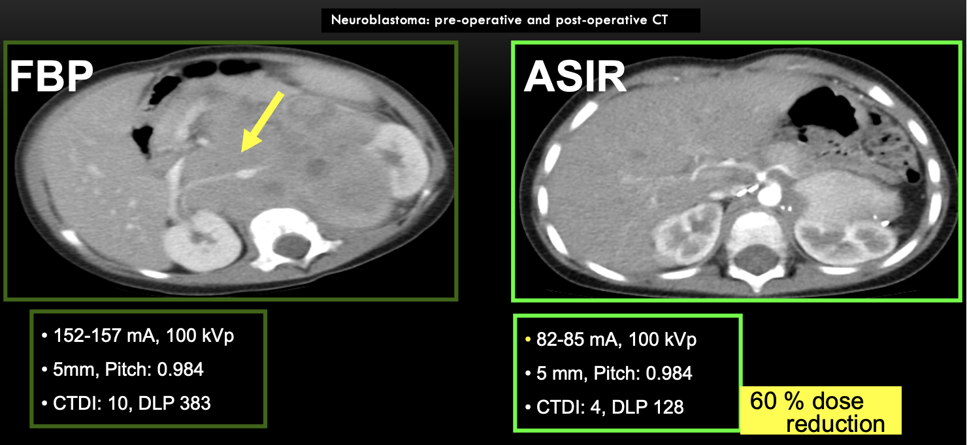


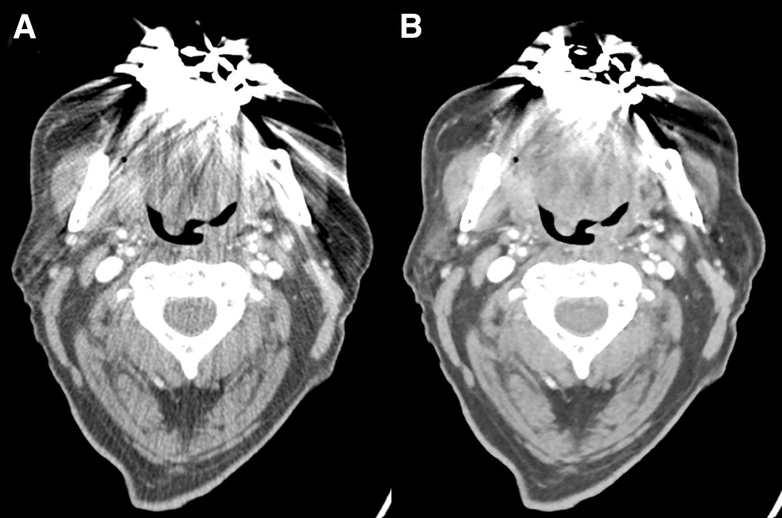


Advantages
Reduction in patient radiation dose
Lower radiation exposure
Enhanced visual image quality
Artifact Suppression
A. FBP with metallic artifacts caused by dental hardware | B. Reduction in metallic artifacts with IR algorithm
2. Nance, J.W., Schoepf, U.J. & Ebersberger, U. The Role of Iterative Reconstruction Techniques in Cardiovascular CT. Curr Radiol Rep 1, 255–268 (2013). https://doi.org/10.1007/s40134-013-0023-y

Slide 13
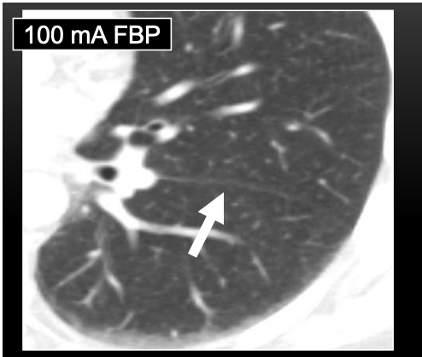


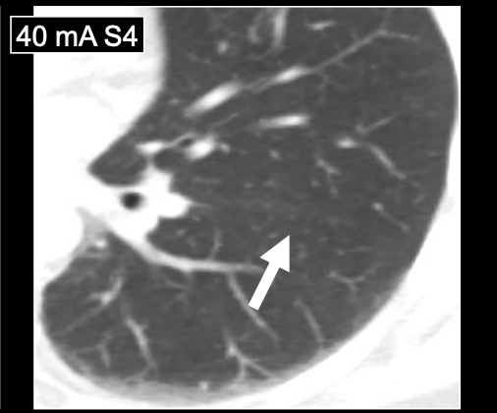

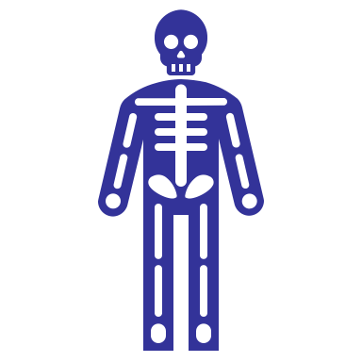
Disadvantages
Practical implementations are complex and expensive
Blotchier image reconstruction
(a) FBP with higher dose
Prolonged reconstruction time
Unseen Pathologies?
(b) Missing Lung fissure with low dose IR
Iterative Reconstruction - Does it Work to Reduce Noise Without Messing up the Images? Sarabjeet Singh, Lecturer of Radiology, Harvard Medical School, Massachusetts General Hospital, Boston, MA, 2114

Slide 14
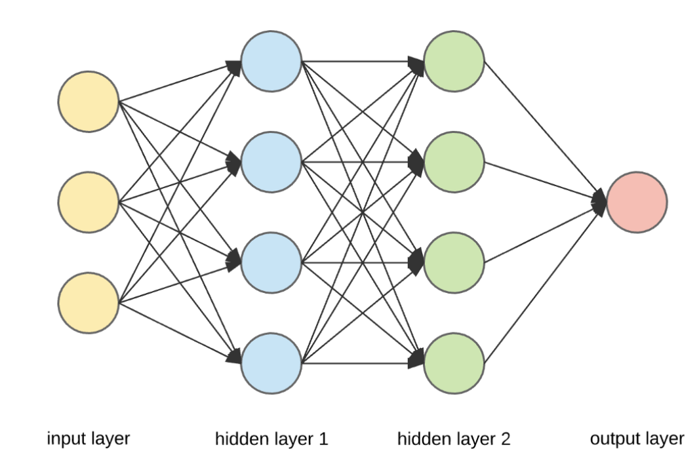
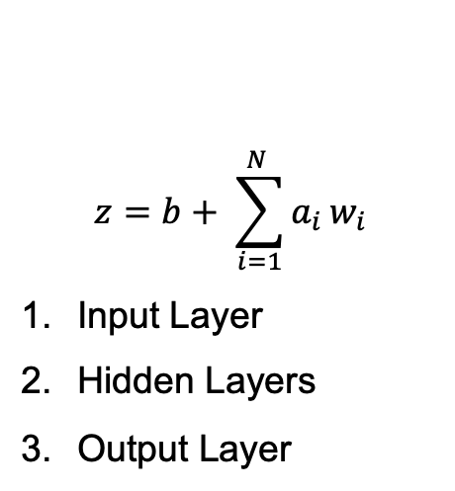
Neural Network
ResNet
$$z=b+ \sum_{i=1}^{N }{a_{i}}w_{i}$$
Input Layer
Hidden Layers
Output Layer
Autoencoder
U-NET
Neural network is used to map the data to a latent space that follows a certain distribution
Reconstructs the data from the latent space
Directional wavelet
FBP based residual network

Slide 15
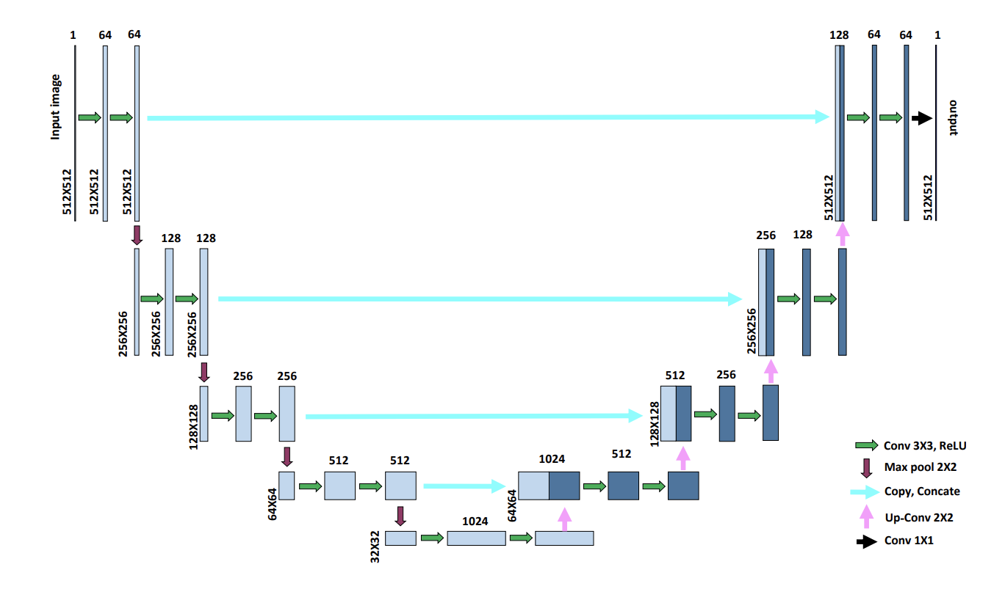
Reconstruction with CNN

Slide 16


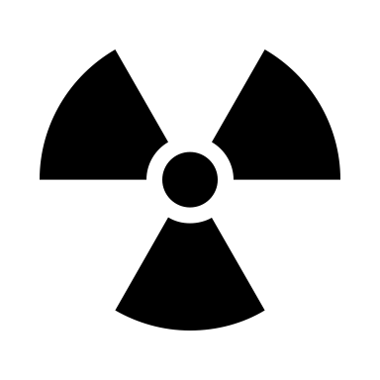
Conclusion
Advantage over other reconstruction methods
Highly accepted
Scope
Can be applied to other imaging modality
GE | Philips | Siemens | Toshiba | MedicVision | MGH
ASIR | iDOSE | IRIS | AIDR | SafeCT | MBAI
MBIR/VEO | IMRS

Slide 17
FIN Questions?

